Slide 1
Covid-19 crisis as a model for data literacy
S. Bottin-Rousseau, A. Rauzy,
Sorbonne University

Slide 2
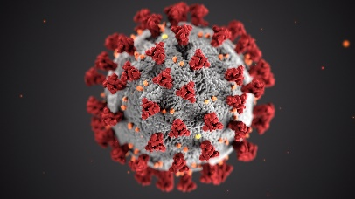
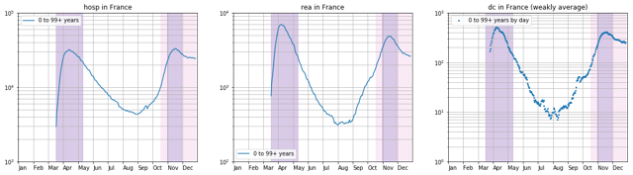
Pedagogical Content
This course is designed to equip you with the knowledge to understand the COVID pandemic in all dimensions: mastering the concept of “model”, manipulating the data, acting in autonomy, exercising your critical thinking and countering fake news.

Slide 3
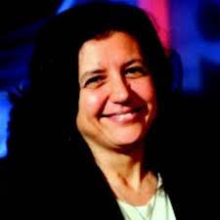
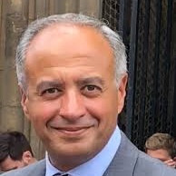
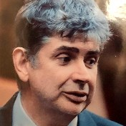
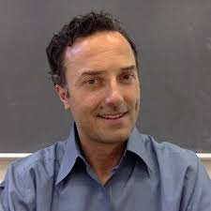
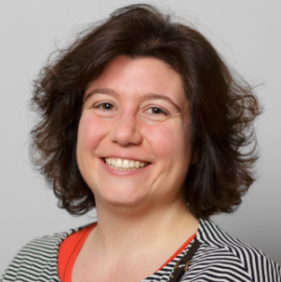
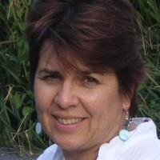
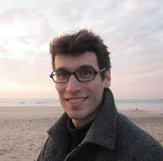
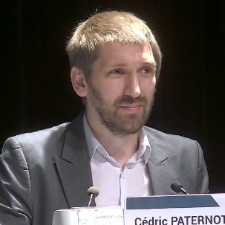
First phase
Multidisciplinary approach
Teachers in health, sciences and humanities will present the researchers’ answers to the issues posed by the pandemic in short videos.
For each expert: 3 videos, followed by quizzes

Slide 4
Expert courses 1/3
Pharmaceutical Science: Giulio Vistoli (UM)
Overview on the opportunities and challenges proposed by the rational discovery of efficient drugs to combat SARS-CoV-2 infection.
Epidemiology: Elia Biganzoli (UM)
Overview of the application of Medical Statistics and Data Science principles to the epidemiological aspects of Covid-19.
Gynaecology: Khaled Ismael (CU)
Overview on the impact of the pandemic on women’s health-related clinical outcomes and service provision in high, low and middle-income healthcare settings
Giulio Vistoli
(UM)
Elia Biganzoli
(UM)
Khaled Ismael
(CU)

Slide 5
Expert courses 2/3
Antonella delle Fave
(UM)
Psychology: Antonella delle Fave (UM)
Resilience is the ability to actively rebound from disruptive life challenges. Covid-19 pandemic is a clear example of an adversarial circumstance, in which resilience represents a key asset supporting the successful functioning of persons, families and communities. Empirical evidence of Covid-related resilience will be provided through results from research studies.
Political Science: Jale Tosun (UH)
Explain the policy responses to the Covid-19 pandemic, with a focus on the comparison of the policy measures adopted at the level of the nation-state.
Jale Tosun
(UH)

Slide 6
Expert courses 3/3
Sociology: Beate Collet (SU)
Overview of some social consequences of lockdown, especially in family and private life sphere. The pandemic not only has an impact on health, but also transforms social relations. The idea is to foster multidimensional thinking including consequences on social relations.
Geography: Olivier Milhaud (SU)
Overview of some geographical dimensions of the pandemic and the manifold circulations (of virus, people, workers, goods, financial flows). It develops critical thinking by considering movements in the context of lockdowns.
Philosophy: Cédric Paternotte (SU)
Why and when are Randomized Controlled Trials (RCTs) the best method of finding efficient treatments in the context of a pandemic? Philosophical arguments regarding the epistemological, ethical and pragmatic aspects of RCTs will be introduced and discussed.
Beate Collet
(SU)
Olivier Milhaud
(SU)
Cédric Paternotte
(SU)

Slide 7
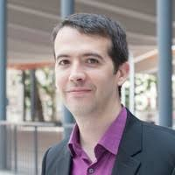
Second phase
Course in Statistics
  Basis statistics for beginners
  More advanced for science students
4 videos, notes, and quizzes
Olivier Lopez
(SU)

Slide 8
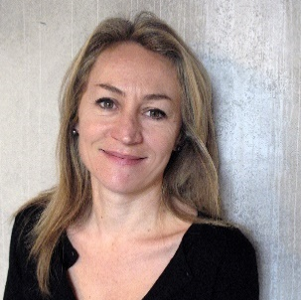
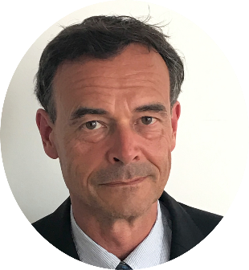
Second phase
Practical training on data in Python language
to better master and understand digital representations
6 Practical labs
to learn the basis of the language and handle data
On JupiterLab with Notebooks
Sabine Bottin-Rousseau
(SU)
Antoine Rauzy
(SU)

Slide 9
Third phase
Research Project
In small international groups, you will do a research project on a subject linked to one of the themes of the short videos. For this project, you will use statistics, data handling and collate the research.

Slide 10
Timeline of the course
Expert courses
1st → 14th of March
Project in international group
1st of April → 30th of May
Statistical course and Practical Labs
15th of March → 15th April
Creation of working groups
1st of April

Slide 11
Time required
Expert courses
8 hours
Project in international group
30 h
Statistical course and Practical Work
8h + 12h
Creation of working groups
2 hours on LMS

Slide 12
Evaluation
Quizzes from Experts | 10
Statistical Course Quizzes | 10
Practical Work | 20
Project in Group 30 content, 30 presentation and workgroup (declaration of the work of each member) | 60
Total | 100

Slide 13
Final Achievement
Your group will write a final report (10 pages max)
Prepare a slideshow presentation
Present and defend it online

Slide 14
Thank you!
S. Bottin-Rousseau, Sorbonne University
Coordinator of the course

